Slide 1
Progress report 04/09
Anh Tuan Cao

Slide 2
Overview
Three types of Incremental learning (continue)
Hyperparameter tunning (continue)
Datasets Exploration
Elastic Weight Consolidation

Slide 3
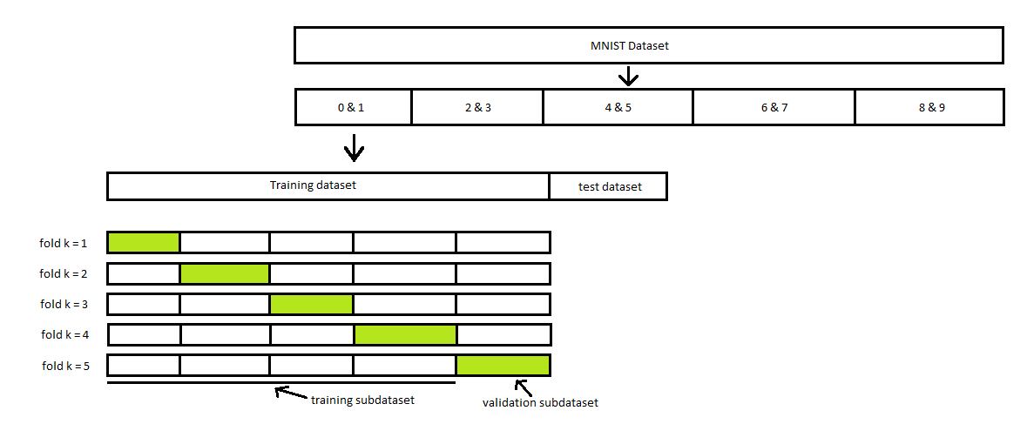
Three types of Incremental learning (Continue)
Dataset: Input

Slide 4
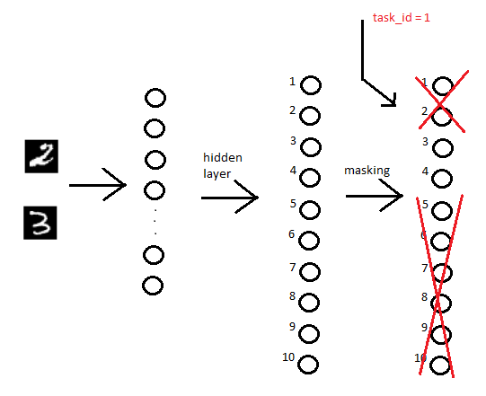
Three types of Incremental learning (Continue)
Task incremental learning
"The 'inactive' class is determined based on task_id.
All outputs corresponding to the 'inactive' class are set to 0."

Slide 5
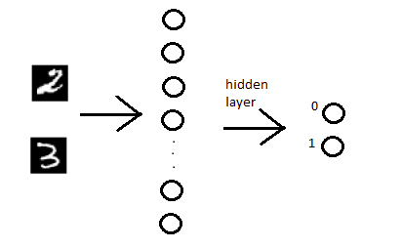
Three types of Incremental learning
Domain incremental learning
Output is restricted to two possible classes: 0 or 1.

Slide 6
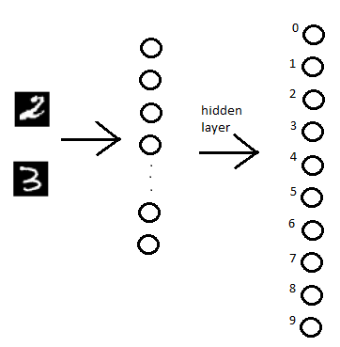
Three types of Incremental learning
Class incremental learning
Operates similarly to standard deep learning models.

Slide 7
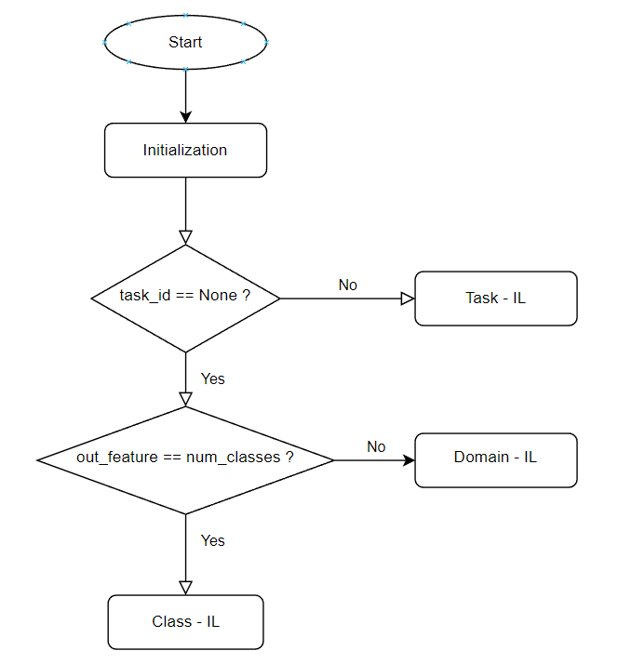
Three types of Incremental learning
Case decision:
Task_id is given => Task incremental learning.
If number of model output equals number of known labels => Class incremental learning
Workaround in Split-MNIST:
Adjusted_labels = true_labels % num_classes
Example:
Domain-IL : 8 % 2 = 0 and 9 % 2 = 1
Class-IL: 0 % 10 = 0, 1 % 10 = 1, 2 % 10 = 2, ect...

Slide 8
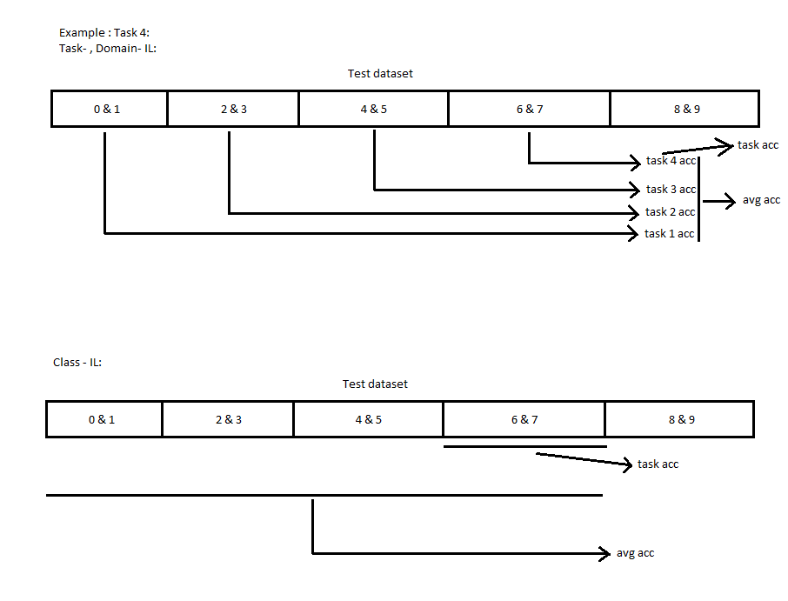
Three types of Incremental learning
Benchmarking / Testing
Performance is evaluated with average accuracy and task accuracy

Slide 9
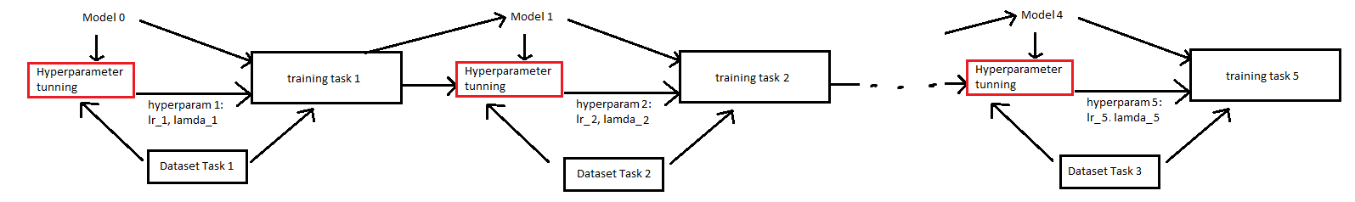
3. Hyperparameter tunning
Idea
Find the best parameters for current tasks.
Hyperparameter tunning before training the new task

Slide 10
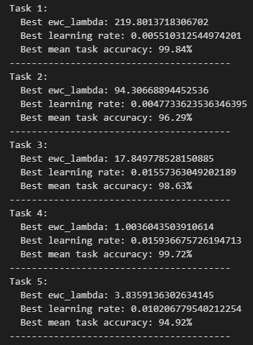
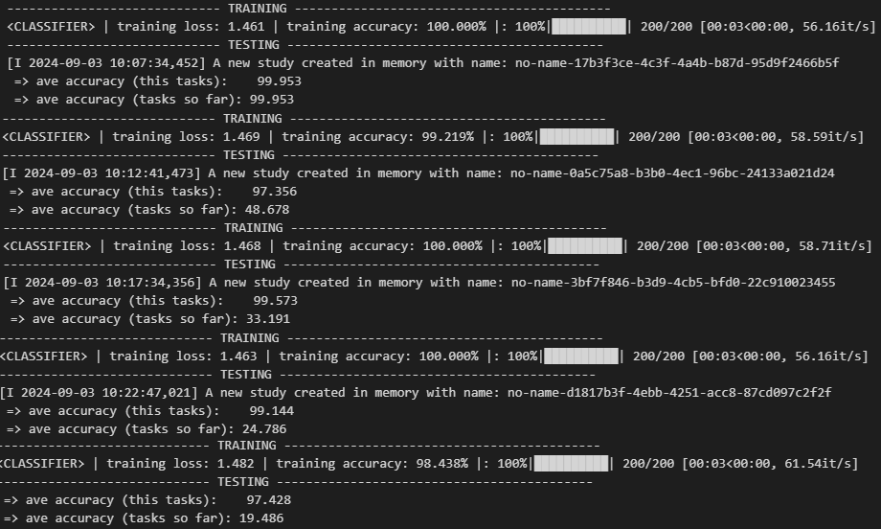
3. Hyperparameter tunning
Result:

Slide 11
4. Dataset Exploration
a) Hard drive Data
The daily snapshot of one drive is one record or row of data.
All of the drive snapshots for a given day are collected into a file consisting of a row for each active hard drive.
Each day this file is named in the format YYYY-MM-DD.csv, for example, 2024-04-01.csv.
The first row of the each file contains the column names, the remaining rows are the actual data.
The columns are as follows:
Date – of the file in yyyy-mm-dd format.
Serial Number – The manufacturer-assigned serial number of the drive.
Model – The manufacturer-assigned model number of the drive.
Capacity – The drive capacity in bytes.
Failure – Contains a “0” if the drive is OK. Contains a “1” if this is the last day the drive was operational before failing.
SMART Start: Self-Monitoring, Analysis and Reporting Technology.

Slide 12
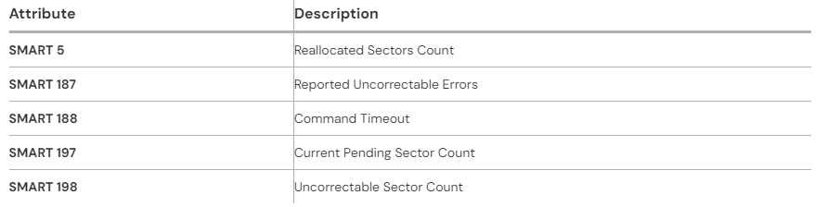
4. Dataset Exploration
a) Hard drive Data
SMART Attribute:
Monitoring system included in SSDs and HDDs.
Detect and report various indicators of drive reliability with the intent of anticipating imminent hardware failures.
Backblaze uses Stats 5 , 187, 188, 197, 198 to predict Hard Drive Failure

Slide 13
4. Dataset Exploration
a) Hard drive Data
SMART Attribute:
Each manufacturer records different types of SMART attribute. For example:
Lifetime Percentage:
SMART 169: Remaining Lifetime Percentage (Western Digital) : 100 for new, decrease to 0.
SMART 202: Percentage of Lifetime Used (Crucial): 0 for new, 100 as for 100% of lifetime used.
SMART 231: Life Left (Seagate): 100 for new, decrease to 0, 10 is threshold for replacement.

Slide 14
4. Dataset Exploration
b) Injection Molding Lego Data
Manufacturing Process: Injection molding is a process used to produce plastic products in a single production step. It involves:
Plasticization: The plastic material is first heated and melted.
Injection: The melted plastic is then injected into a mold cavity, where it takes the shape of the desired product.
Cooling: The plastic cools down within the mold, solidifying into the final product shape.
Study Objective:
Predict quality metrics of parts : maximum deformation of parts under load
Data:
There are 16 classes of plastic blocks, created by combining different configurations of studs and rows:
Studs per row: 1, 3, 6, or 8
Rows: 1 or 2
There are 77 examples for each part by varying the input parameters
Each class of block has distinct characteristics or statistics.

Slide 15
4. Dataset Exploration
b) Injection Molding Lego Data
Part characteristics:
Holding Pressure Level: The pressure applied to compact the plastic material after injection to ensure full mold filling and part accuracy.
Holding Pressure Time: Duration the holding pressure is applied to control part solidification and prevent shrinkage or defects.
Mold Temperature: Temperature of the mold, affecting cooling rate, surface quality, and part stability.
Cooling Time: Time allowed for the part to cool and solidify in the mold, preventing deformation after ejection.
Melt Temperature: Temperature of the plastic melt, influencing flowability and the ability to fill the mold properly.
Volume Flow: Rate at which the molten plastic is injected into the mold, affecting filling quality and potential defects.

Slide 16
4. Dataset Exploration
b) Wafer surface defect detection
Wafers: In semiconductor manufacturing, a wafer is a thin slice of semiconductor material, such as silicon, used to fabricate integrated circuits and other microdevices.
Yield: This refers to the percentage of good (functional) chips on a wafer. The higher the yield, the more efficient and cost-effective the manufacturing process is.
Study Objective:
Identify different types of wafer map failure pattern.
Data:
There are images of wafer map with/without its failure pattern labels.
0 is for non-wafer area
1 is for non-failure wafer area
2 is for failure wafer area
Each images has different dimension

Slide 17
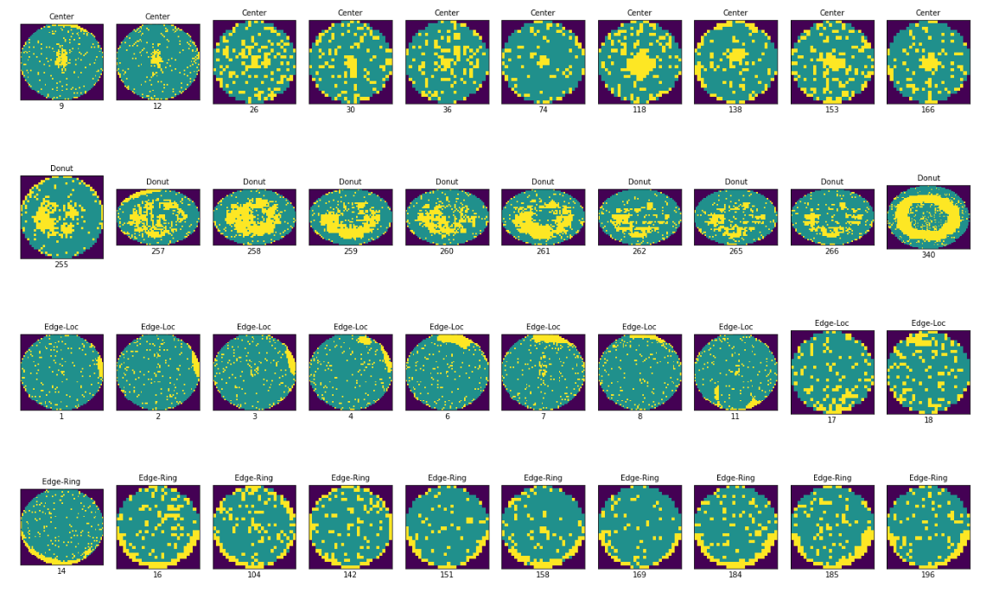
4. Dataset Exploration
b) Wafer surface defect detection

Slide 18
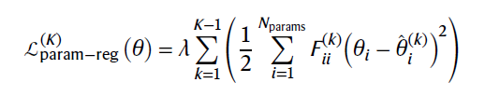
2. Elastic Weight consolidation
Parameter Regularization
Evaluate each parameters importance to the network.
Keep the important parameters static to maintain former knowledge.
EWC
Consider quadratic penalty term for last learned context:

Slide 19

2. Elastic Weight consolidation
Fischer Information Matrix
Evaluate each parameters importance to the network.
Keep the important parameters static to maintain former knowledge.

